Slide 1

Analyzing Swiggy
Bangalore delivery outlet data
By
Mamta M. Natu

Slide 2
Introduction
Problem Statement
The online food ordering market includes foods prepared by restaurants, prepared by independent people, and groceries being ordered online and then picked up or delivered. The first online food ordering service, World Wide Waiter (now known as Waiter.com), was founded in 1995. Online food ordering is the process of ordering food from a website or other application. The product can be either ready-to-eat food or food that has not been specially prepared for direction consumption.

Slide 3
OBJECTIVES AND BENIFITS
1) Enhance Delivery Time and Cost-Effective
Data Science and analytics help them to optimize time and cost. So, if any circumstances occur, they know what to do and encourage them.
2) Evaluate customer behaviour
Big Data Analytics and Data Science are known for the data which can help them predict customer behavior.
3) Location-based Promotion
The benefit of Big Data Analytics is that it enables the food-tech company to target customers by creating use of real-time location and at the right time.

Slide 4
TASK
Do ETL : Extract-Transform-Load the dataset and find for me some information from this large data.
This is form of data mining.
What all information can be achieved by mining this data, would be explained in class by the trainer
Find key metrics and factors and show the meaningful relationships between attributes.
Do your own research and come up with your findings.

Slide 5
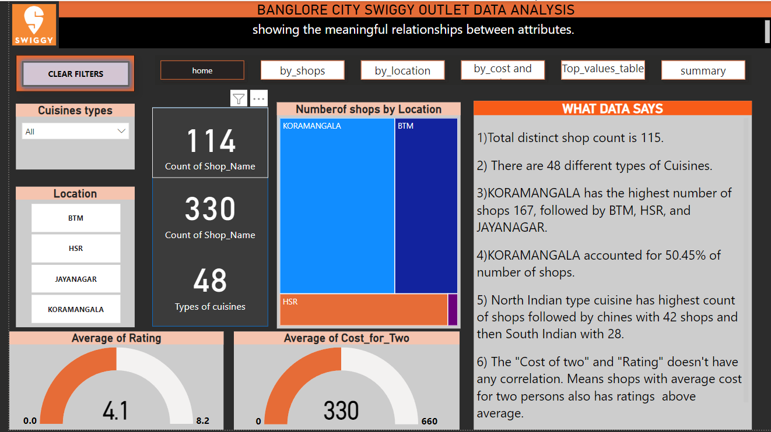
Numeric summary of data
Cards: Showing numeric information about data
Tree map: Shows maximum number of outlets in Koramangala location.
Guage1: Shows average of ratings is 4.1
Guage2: Shows average of cost for two is 330 Rupees.

Slide 6
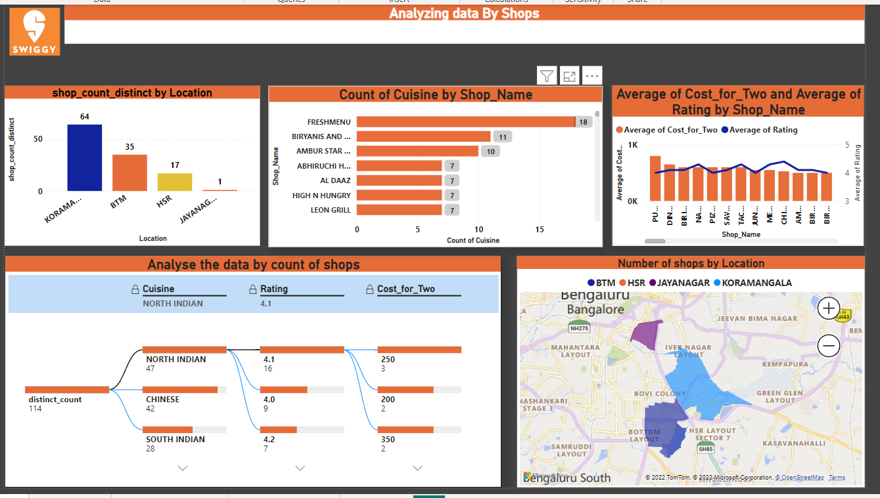
Analysis by Distinct Shops
Stacked column chart : show highest distinct shop count is at koromangala.
Clustered bar chart: Show Fresh Menu shop has highest count of cuisines.
Line and clustered column chart: Gives distribution of average cost for two and average ratings over different shop names.
Decomposition Tree: It show distribution the count of distinct cuisines with rating and then cost for two.
Filled map: show the distribution of location over Bengaluru map.

Slide 7
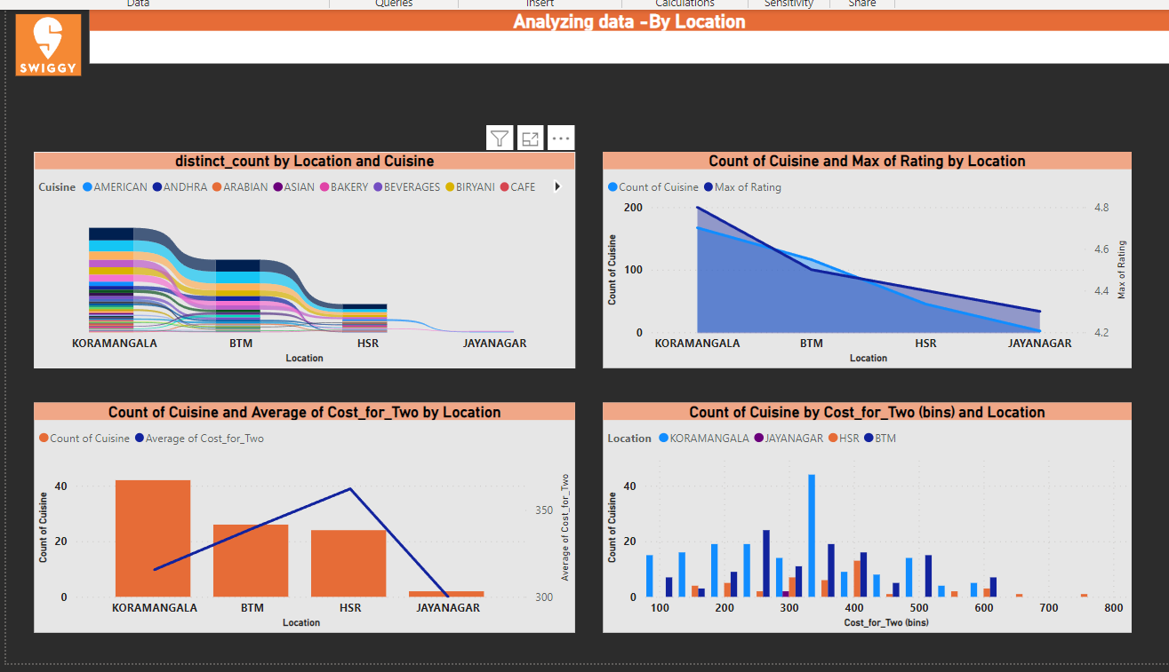
Analysis by Location
Ribbon chart: show how the distinct count of shops changes over different location, sorted descending.
Area chart: shows the area occupied by count of cuisines and its average ratings over different locations.
Line and stacked column chart: it show the distribution of count of cuisines with average cost for two over locations.
Clustered column chart: it shows cost for two over different location is normally distributed with mean cost Rs. 350.

Slide 8
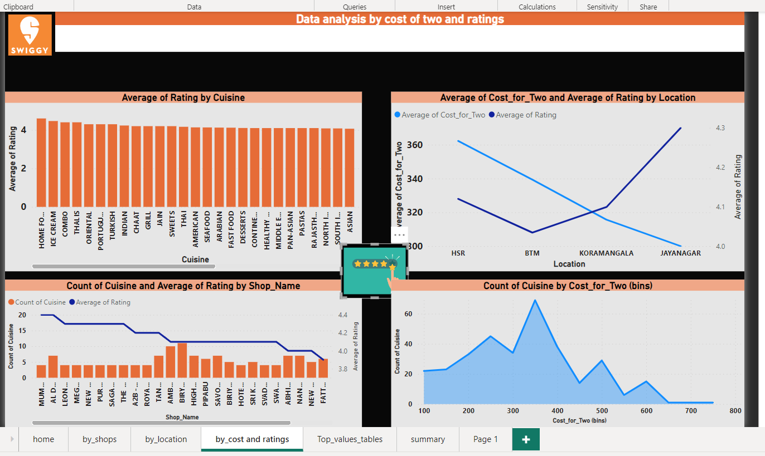
Analysis by Cost for two and Ratings
Clustered column chart: It shows the distribution of Cuisines with descending ratings.
Line chart: it gives average cost for two with average ratings over different locations.
Line and stacked column chart: it gives the distribution of shops name showing descending ratings with count of cuisines.
Histogram: it shows distribution of different ranges of cost of two over cuisine type.

Slide 9
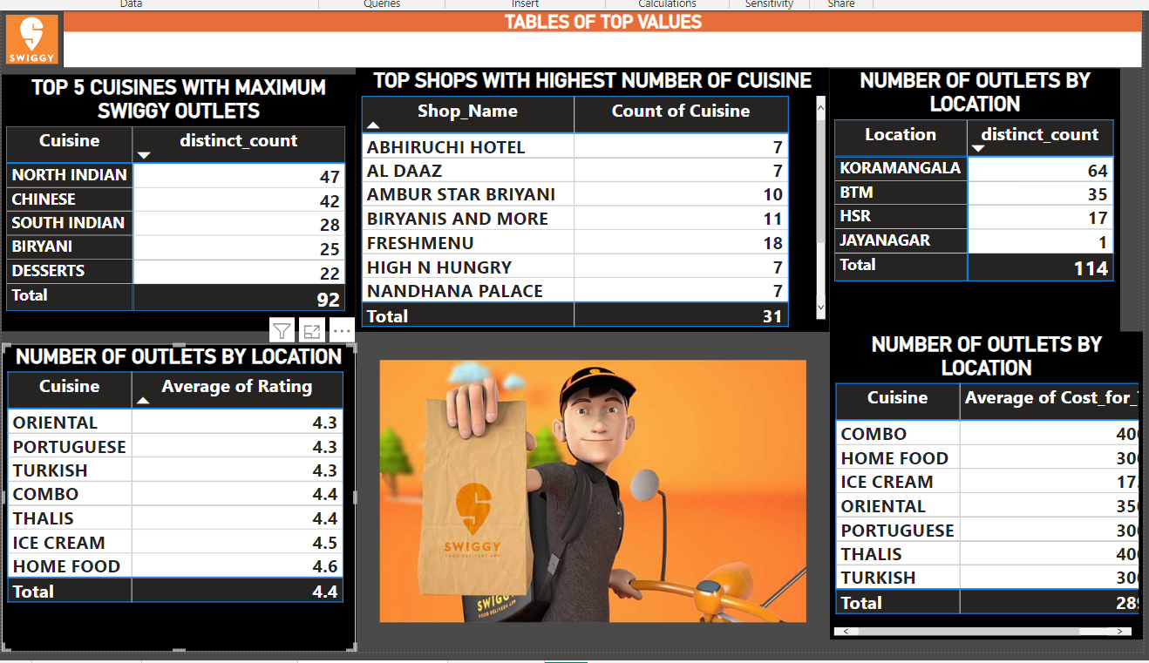
Top values tables
Here gives different tables showing top values
Top 5 cuisines with Maximum outlets
Top shops with highest number if cuisines
Top 5 cuisines by average cost for two
Top 5 cuisines by average ratings
Number of outlets by location.

Slide 10
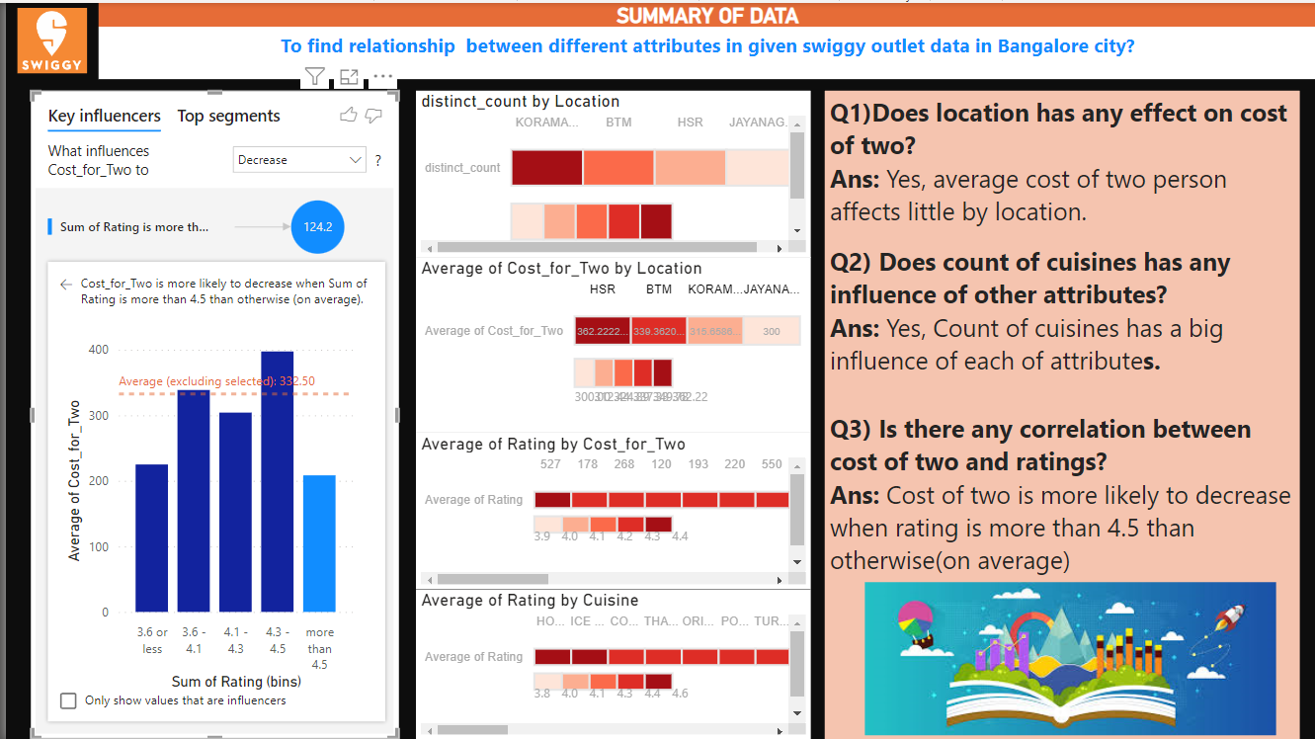
Summary page
Heat map used to show correlation between different attributes in data.
Key influencer is used to find the effect of ratings on cost for two persons.
Text box showing question answer about relationship between different attributes in data.

Slide 11
Thank you

